Slide 1
GPU monitoring on LUMI-G with ROCm-smi
Magnar Bjørgve, UiT/NRIS/NAIC

Slide 2
ROCm-SMI on LUMI-G
ROCm System Management Interface (ROCm SMI)
Tool for users to monitor GPU applications
Similar to nvidia-smi
ROCm-SMI enables real-time monitoring of both GPU computational loads and memory utilization
ROCm-SMI can be used to determine the toplogy of GPU interconnects within the system

Slide 3
A sample on Toplogy
What are we running on and how is it connected?
We can use ROCm-SMI to figure it out.

Slide 4
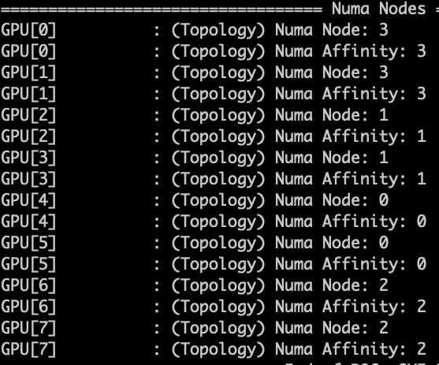
NUMA (Non-Unifrom Memory access Nodes)
NUMA Nodes represent the “closeness” of memory to GPUs
Each GPU is associated with a specific NUMA Node
Optimizing for NUMA Node affinity can reduce memory latency

Slide 5
Link types between GPUs (XGMI Interconnects)
XGMI: High-speed links for GPU peer communication
On an Nvidia system you would probably see NV4

Slide 6
Hops between GPUs (Direct Connectivity Topology)
One hop between GPU pair (0-7) illustrates a fully connected setup
Direct GPU links reduce data travel time and latency
Ensures minimal communication overhead for better throughput

Slide 7
GPU usage
Questions to ask ourselves:
Am I running on a GPU?
Am I using my resources well?
We notice we get a 10x speed up if we go from 1 to 10 GPUs
Looking at ROCm-SMI data we see we use less than 10% of each GPU

Slide 8
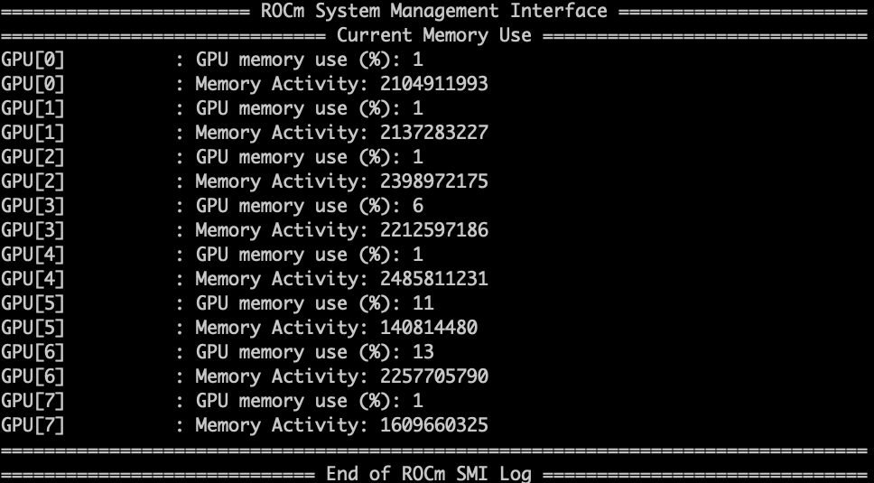
GPU usage

Slide 9
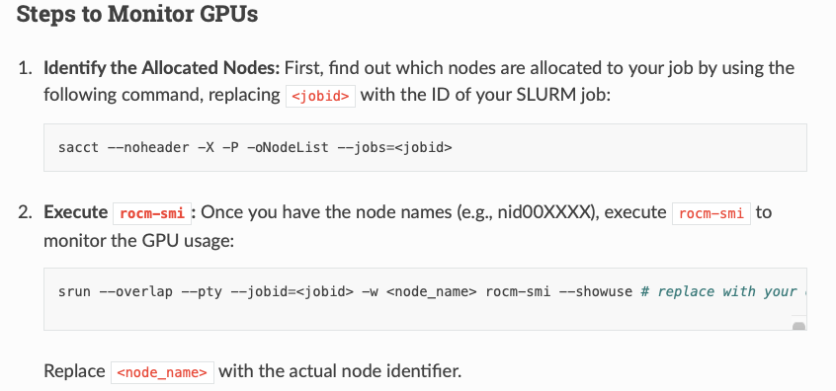
GPU usage

Slide 10
GPU sampling in a job script

Slide 11
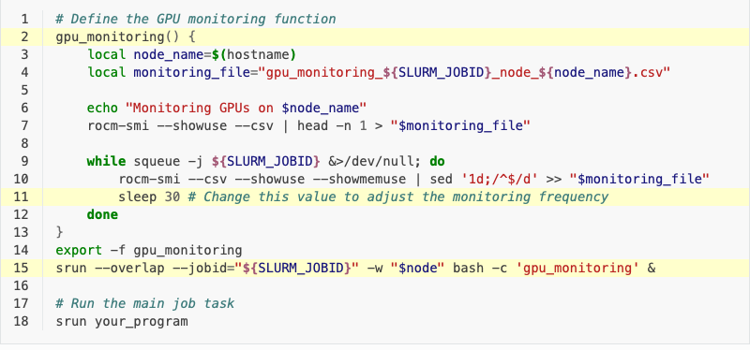
GPU sampling in a job script
For more info and how to sample on multiple-nodes check the QR code
More in our documetation:

Slide 12
Jax on LUMI-G
Magnar Bjørgve, UiT/NRIS/NAIC

Slide 13
What is Jax?
"JAX is NumPy on the CPU, GPU, and TPU, with great automatic differentiation for high-performance machine learning research.”
Source: Jax Documentation
It is well suited for building AI models from scratch
Jax documentation

Slide 14
Is Jax fast?
Source: “Intro to JAX: Accelerating Machine Learning research”
URL: https://www.youtube.com/watch?v=WdTeDXsOSj4
Accessed: 11.01.24

Slide 15
On todays agenda
Installing Jax on LUMI-G
Highlight key-features of Jax (with code examples)
Numpy like
Automatic differensiation
Vectorization
Just in time compilation
Parallelization across multiple GPUs on a single node
Parallelization across multiple GPUs on multiple nodes
Live demo

Slide 16
Installation on LUMI-G
Locate container with Jax that can be installed to your user/project with EasyBuild:
Suitable images can be found here:

Slide 17
Installation on LUMI-G
Create an easybuild config file:
Install:

Slide 18
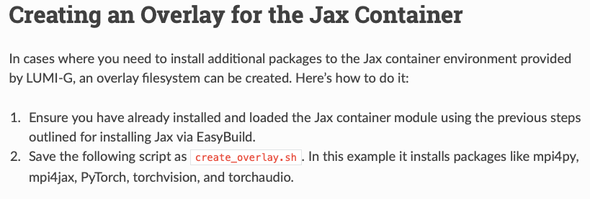
Adding more packages

Slide 19
More on Jax
Lightweight NumPy-like API for array-based computing
Composable function transformations
Automatic differensiation
Just in time compilation (JiT)
Vectorization
Parallelization
We can execute it on CPU, TPU or GPU without chaning the code

Slide 20
The code examples I’ll show are available here:

Slide 21
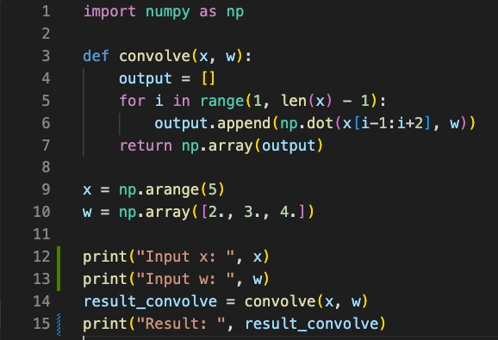
It’s numy like API

Slide 22
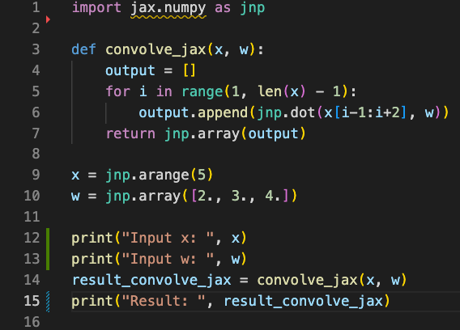
It’s numy like API

Slide 24
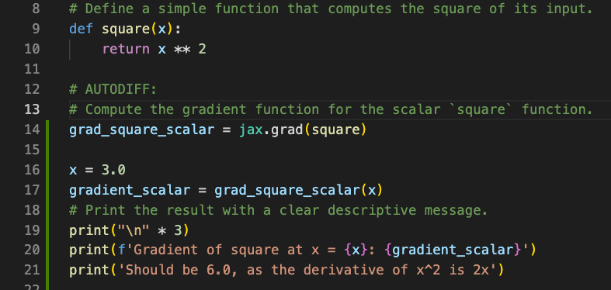
Automatic differensiation

Slide 25
Automatic differensiation

Slide 26
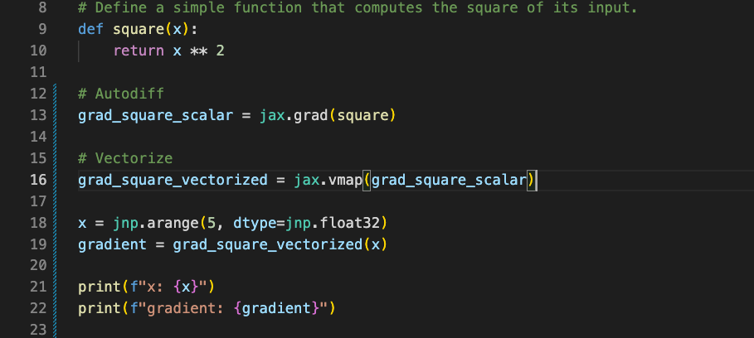
Vectorization

Slide 27
Vectorization

Slide 28
Just in time compilation
“Jax.jit”
returns a function that is compiled and runs on accelerators or the cpu

Slide 29
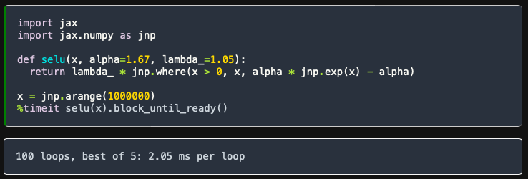
JiT on Scaled Exponential Linear Unit (SELU)
Order of magnitude faster
Source: https://jax.readthedocs.io/en/latest/jax-101/02-jitting.html

Slide 30
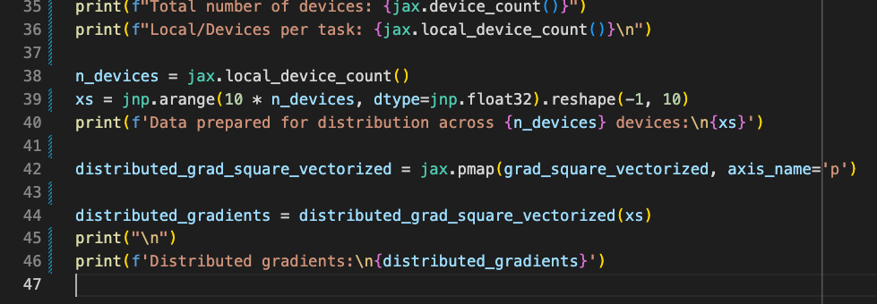
Parallelization on a single node (8 gpus)

Slide 31
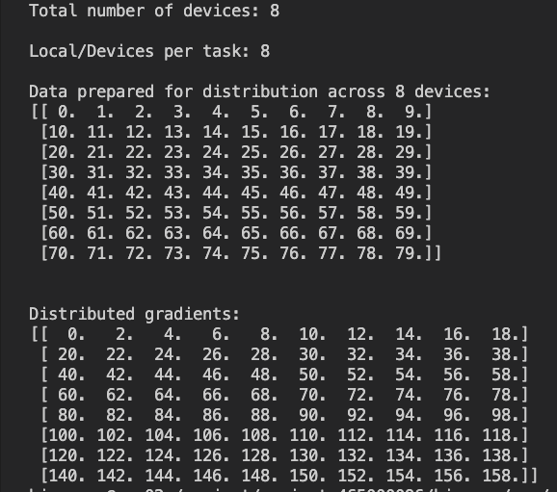
Parallelization on a single node (8 gpus)

Slide 32
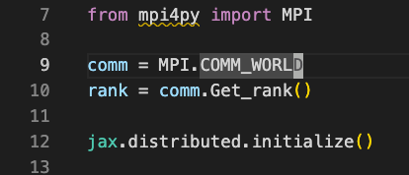
Distributed on N-nodes

Slide 33
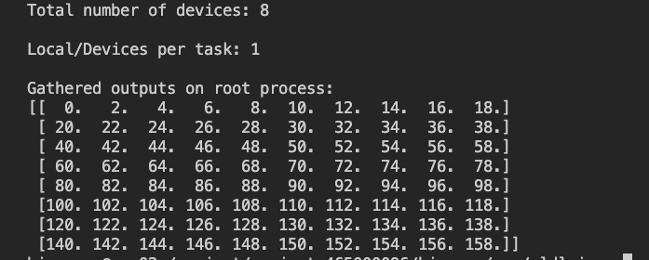
Output on 8 GPUs on a Single node

Slide 34
Result compared to “naïve” distribution

Slide 35
Can we do this on more than a single node?
Let’s try!

